Slide 1
Finite Automata
CS 4100
Gordon Stewart
Ohio University

Slide 2
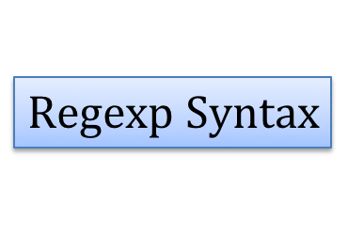
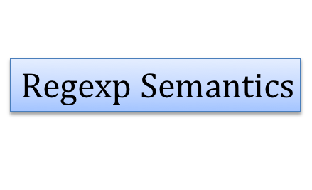
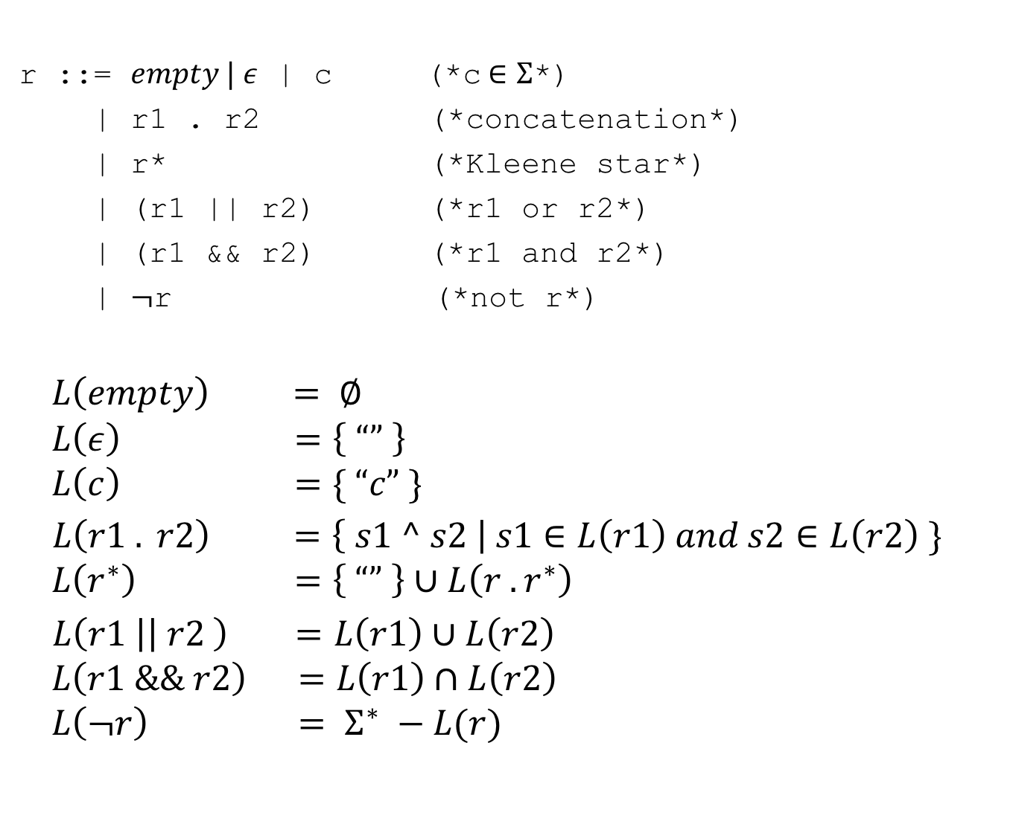
A Language of Regexps
r ::= $empty | ε$ | c (*c$∈Σ$*)
| r1 . r2 (*concatenation*)
| r* (*Kleene star*)
| (r1 || r2) (*r1 or r2*)
| (r1 && r2) (*r1 and r2*)
| $¬$r (*not r*)
$$L\left(empty\right) = ∅$$
$$L\left(ε\right) =\left\{ “” \right\}$$
$$L\left(c\right) =\{ “c” \}$$
$L\left(r1 . r2\right) =\left\{ s1 ^ s2 \right| s1∈L\left(r1\right) and s2∈L\left(r2\right) \}$
$$L\left(r^{∗}\right) =\left\{ “” \right\}∪L\left(r . r^{∗}\right)$$
$L\left(r1 \right|\left| r2 \right) =L\left(r1\right)∪L\left(r2\right)$
$$L\left(r1 \&\& r2\right) =L\left(r1\right)∩L\left(r2\right)$$
$$L\left(¬r\right) = Σ^{∗} −L(r)$$
$$Regexp Syntax$$
$$Regexp Semantics$$

Slide 3
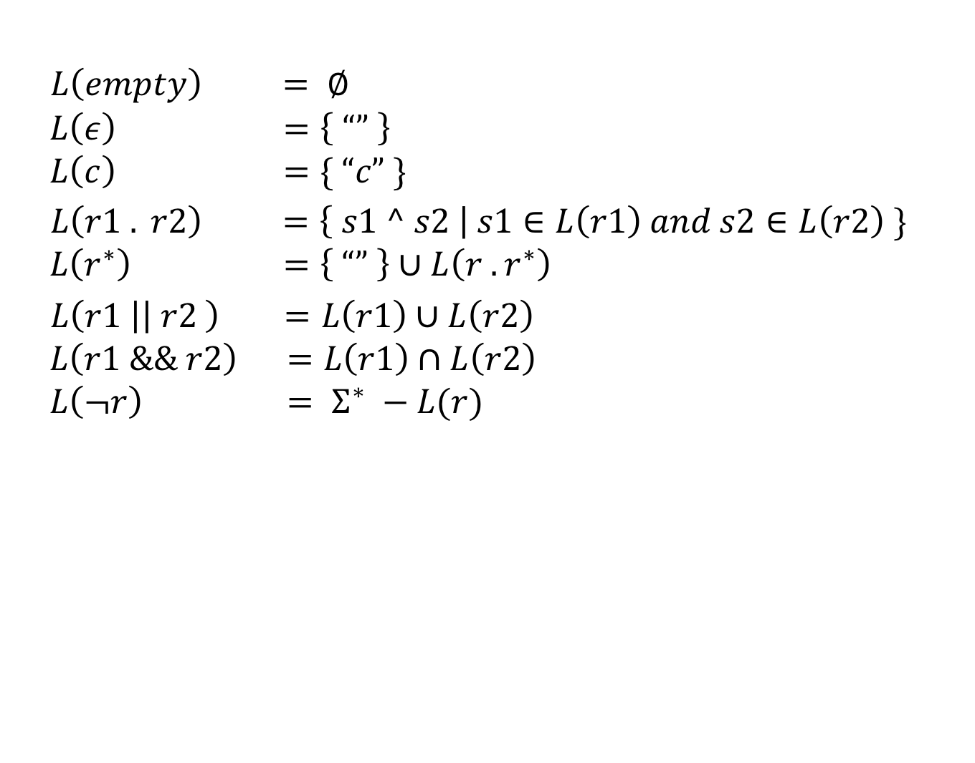
A Naïve Implementation
$L\left(empty\right) = ∅$
$$L\left(ε\right) =\left\{ “” \right\}$$
$$L\left(c\right) =\{ “c” \}$$
$L\left(r1 . r2\right) =\left\{ s1 ^ s2 \right| s1∈L\left(r1\right) and s2∈L\left(r2\right) \}$
$$L\left(r^{∗}\right) =\left\{ “” \right\}∪L\left(r . r^{∗}\right)$$
$L\left(r1 \right|\left| r2 \right) =L\left(r1\right)∪L\left(r2\right)$
$$L\left(r1 \&\& r2\right) =L\left(r1\right)∩L\left(r2\right)$$
$$L\left(¬r\right) = Σ^{∗} −L(r)$$
$$Regexp Semantics$$
Problem: Is string s in the language of r1 . r2?
Naïve Approach:
Consider all strings s’ formed by s1 ^ s2, where
s1 drawn from L(r1)
s2 drawn from L(r2)
In general, there are O(size(L(r1)) * size(L(r2))) such strings.
Check whether s = s’.

Slide 4
A Slightly Better Implementation
$L\left(empty\right) = ∅$
$$L\left(ε\right) =\left\{ “” \right\}$$
$$L\left(c\right) =\{ “c” \}$$
$L\left(r1 . r2\right) =\left\{ s1 ^ s2 \right| s1∈L\left(r1\right) and s2∈L\left(r2\right) \}$
$$L\left(r^{∗}\right) =\left\{ “” \right\}∪L\left(r . r^{∗}\right)$$
$L\left(r1 \right|\left| r2 \right) =L\left(r1\right)∪L\left(r2\right)$
$$L\left(r1 \&\& r2\right) =L\left(r1\right)∩L\left(r2\right)$$
$$L\left(¬r\right) = Σ^{∗} −L(r)$$
$$Regexp Semantics$$
Problem: Is string s in the language of r1 . r2?
Slightly Better Approach:
Consider all splittings of s = s1 ^ s2. E.g.,
If s = “hello”, then
splittings = {(“”, “hello”), (“h”,“ello”), (“he”,“llo”), …}.
String s is in L(r1 . r2) iff there exists a splitting (s1, s2) such that
s1 is in L(r1) and
s2 is in L(r2).
How many splittings of a string of length n?

Slide 5
A Slightly Better Implementation
$L\left(empty\right) = ∅$
$$L\left(ε\right) =\left\{ “” \right\}$$
$$L\left(c\right) =\{ “c” \}$$
$L\left(r1 . r2\right) =\left\{ s1 ^ s2 \right| s1∈L\left(r1\right) and s2∈L\left(r2\right) \}$
$$L\left(r^{∗}\right) =\left\{ “” \right\}∪L\left(r . r^{∗}\right)$$
$L\left(r1 \right|\left| r2 \right) =L\left(r1\right)∪L\left(r2\right)$
$$L\left(r1 \&\& r2\right) =L\left(r1\right)∩L\left(r2\right)$$
$$L\left(¬r\right) = Σ^{∗} −L(r)$$
$$Regexp Semantics$$
Problem: Is string s in the language of r1 . r2?
A Better Slightly Better Approach:
Brzozowksi derivatives!

Slide 6
FINITE AUTOMATA

Slide 7
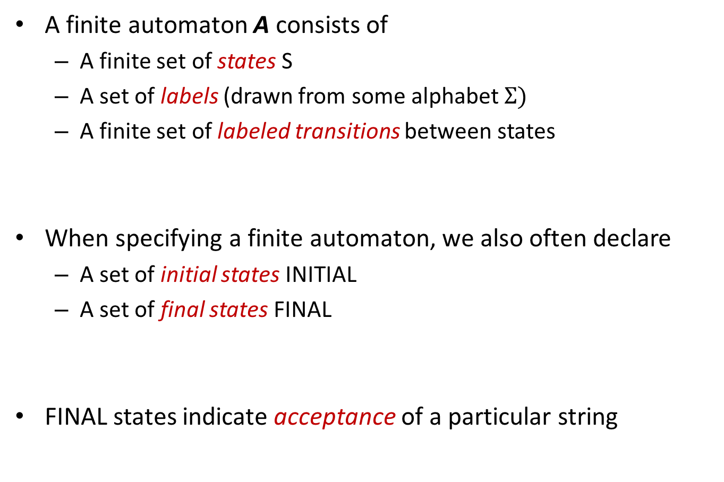
Finite Automata
A finite automaton A consists of
A finite set of states S
A set of labels (drawn from some alphabet $Σ)$
A finite set of labeled transitions between states
When specifying a finite automaton, we also often declare
A set of initial states INITIAL
A set of final states FINAL
FINAL states indicate acceptance of a particular string

Slide 8
A Simple Example
States S = {s1, s2, s3}
Labels = { a }
Transitions = { (s1, a, s2), (s2, a, s3) }
INITIAL states = { s1 }
FINAL states = { s3 }
Which strings does this automaton accept?
Double circle indicates FINAL state

Slide 9
A Second Example
States S = {s1, s2, s3,s4,s5}
Labels = { a, b }
Transitions = { (s1, a, s2), (s2, a, s3), (s3, b, s4), (s4, b, s1) }
INITIAL = { s1 }
FINAL = { s3 }

Slide 10
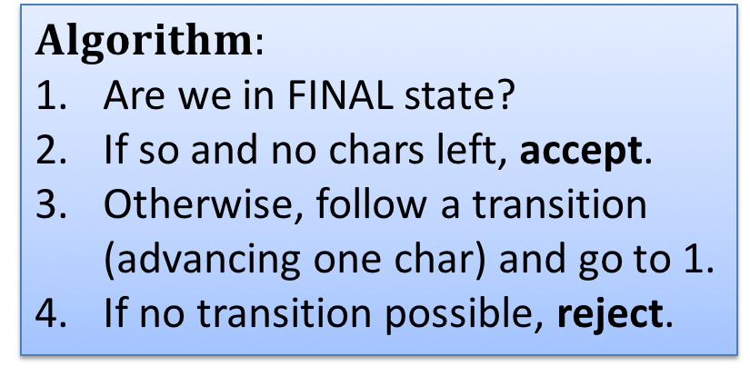
Does an Automaton Match a String?
“aabbaa”
INITIAL
$$Algorithm:$$
Are we in FINAL state?
If so and no chars left, accept.
Otherwise, follow a transition (advancing one char) and go to 1.
If no transition possible, reject.
Position 0

Slide 11
Does an Automaton Match a String?
“aabbaa”
$$Algorithm:$$
Are we in FINAL state?
If so and no chars left, accept.
Otherwise, follow a transition (advancing one char) and go to 1.
If no transition possible, reject.
Position 1

Slide 12
Does an Automaton Match a String?
“aabbaa”
$$Algorithm:$$
Are we in FINAL state?
If so and no chars left, accept.
Otherwise, follow a transition (advancing one char) and go to 1.
If no transition possible, reject.

Slide 13
Does an Automaton Match a String?
“aabbaa”
$$Algorithm:$$
Are we in FINAL state?
If so and no chars left, accept.
Otherwise, follow a transition (advancing one char) and go to 1.
If no transition possible, reject.

Slide 14
Does an Automaton Match a String?
“aabbaa”
$$Algorithm:$$
Are we in FINAL state?
If so and no chars left, accept.
Otherwise, follow a transition (advancing one char) and go to 1.
If no transition possible, reject.

Slide 15
Does an Automaton Match a String?
“aabbaa”
$$Algorithm:$$
Are we in FINAL state?
If so and no chars left, accept.
Otherwise, follow a transition (advancing one char) and go to 1.
If no transition possible, reject.

Slide 16
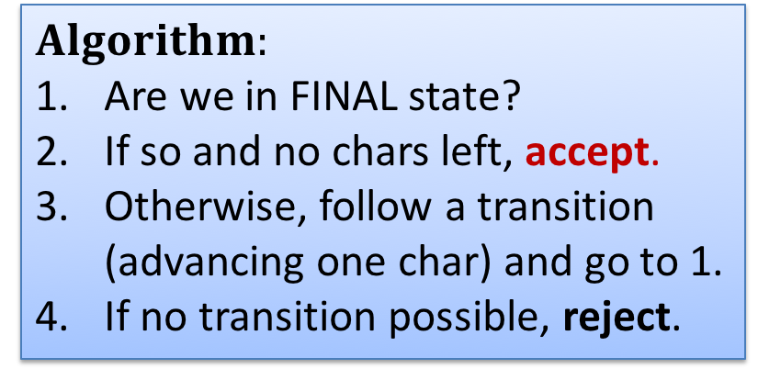
Does an Automaton Match a String?
“aabbaa”
$$Algorithm:$$
Are we in FINAL state?
If so and no chars left, accept.
Otherwise, follow a transition (advancing one char) and go to 1.
If no transition possible, reject.

Slide 17
Does an Automaton Match a String?
“aabb”
INITIAL
$$Algorithm:$$
Are we in FINAL state?
If so and no chars left, accept.
Otherwise, follow a transition (advancing one char) and go to 1.
If no transition possible, reject.
Position 0

Slide 18
Does an Automaton Match a String?
“aabb”
$$Algorithm:$$
Are we in FINAL state?
If so and no chars left, accept.
Otherwise, follow a transition (advancing one char) and go to 1.
If no transition possible, reject.
Position 1

Slide 19
Does an Automaton Match a String?
“aabb”
$$Algorithm:$$
Are we in FINAL state?
If so and no chars left, accept.
Otherwise, follow a transition (advancing one char) and go to 1.
If no transition possible, reject.

Slide 20
Does an Automaton Match a String?
“aabb”
$$Algorithm:$$
Are we in FINAL state?
If so and no chars left, accept.
Otherwise, follow a transition (advancing one char) and go to 1.
If no transition possible, reject.

Slide 21
Does an Automaton Match a String?
“aabb”
$$Algorithm:$$
Are we in FINAL state?
If so and no chars left, accept.
Otherwise, follow a transition (advancing one char) and go to 1.
If no transition possible, reject.

Slide 22
Does an Automaton Match a String?
“aabb”
Not a final state
so don’t accept!
$$Algorithm:$$
Are we in FINAL state?
If so and no chars left, accept.
Otherwise, follow a transition (advancing one char) and go to 1.
If no transition possible, reject.
No more input…

Slide 23
NFAs: Nondeterministic finite automata

Slide 24
A (Nondeterministic) Example
START
a
a

Slide 25
A (Nondeterministic) Example
START
a
a
Multiples of length 2
“aa”
“aaaa”
“aaaaaa”
“aaaaaaaa”
…

Slide 26
A (Nondeterministic) Example
START
a
a
Multiples of length 3
“aaa”
“aaaaaa”
“aaaaaaaaa”
“aaaaaaaaaaaa”
…
Multiples of length 2
“aa”
“aaaa”
“aaaaaa”
“aaaaaaaa”
…

Slide 27
A (Nondeterministic) Example
START
a
a
“aaaa”

Slide 28
A (Nondeterministic) Example
START
a
a
Nondeterministically “guess”
which path to take…must guess correctly! (automaton accepts if any path leads to accept state)
“aaaa”

Slide 29
A (Nondeterministic) Example
START
a
a
“aaaa”

Slide 30
A (Nondeterministic) Example
START
a
a
“aaaa”

Slide 31
A (Nondeterministic) Example
START
a
a
“aaaa”

Slide 32
A (Nondeterministic) Example
START
a
a
End-of-input + final state = accept
“aaaa”

Slide 33
A (Nondeterministic) Example
Alternatively…consider all paths.
Accept if any path accepts.
START
a
a

Slide 34
A (Nondeterministic) Example
Alternatively…consider all paths.
Accept if any path accepts.
START
a
a
“aaaa”

Slide 35
A (Nondeterministic) Example
Alternatively…consider all paths.
Accept if any path accepts.
START
a
a
At nondeterministic transitions (epsilon or otherwise), explore all possible paths…
“aaaa”

Slide 36
A (Nondeterministic) Example
START
a
a
“aaaa”

Slide 37
A (Nondeterministic) Example
START
a
a
“aaaa”

Slide 38
A (Nondeterministic) Example
START
a
a
“aaaa”

Slide 39
A (Nondeterministic) Example
START
a
a
Not a final state but it doesn’t matter…accept if at least one path accepts.
End-of-input + final state = accept
“aaaa”

Slide 40
Nondeterminism without epsilon

Slide 41
Nondeterminism without Epsilon
INITIAL
Which strings does this NFA accept?
Path Lower
Path Upper
“b”
“ba”
”baa”
”baa…”
“bb”
“bba”
“bbaa”
“bbaa…”

Slide 42
Summary: DFAs vs. NFAs
DFA: A deterministic finite automaton is characterized by
Deterministic transition relation: For each state and input character, at most one next state
Exactly one initial state
Typically not drawn with epsilon transitions
NFA: A nondeterministic finite automaton is characterized by
A (potentially) nondeterministic transition relation: For each state and input character, possibly more than one next state
Possibly many initial states
Typically drawn using epsilon transitions, though an automaton may be nondeterministic even without epsilon
Every DFA is trivially also an NFA.

Slide 43
NFA->DFA: the Powerset Algorithm

Slide 44
Reducing NFAs to DFAs
START
a
a
It might seem like NFAs are strictly more powerful than DFAs – they can guess!
In fact, they recognize exactly the same set of languages.
Skeptical?

Slide 45
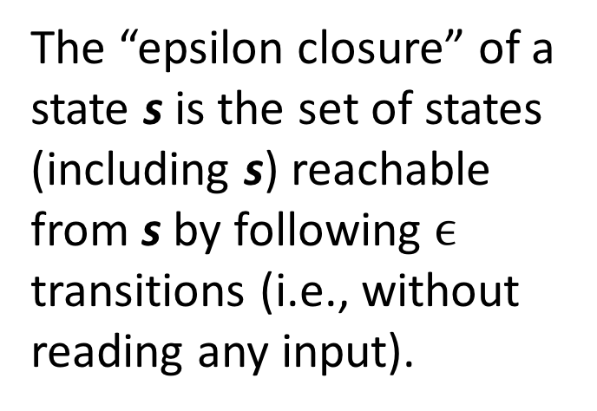
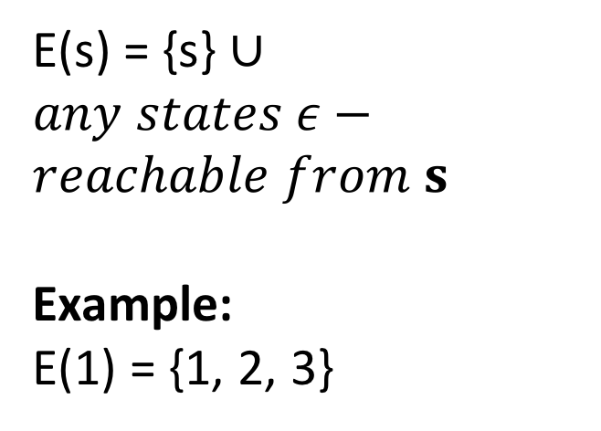
Epsilon Closure
START
a
1
a
2
3
The “epsilon closure” of a state s is the set of states (including s) reachable from s by following $ϵ$ transitions (i.e., without reading any input).
E(s) = {s} $∪any states ε−reachable from s$
Example:
E(1) = {1, 2, 3}

Slide 46
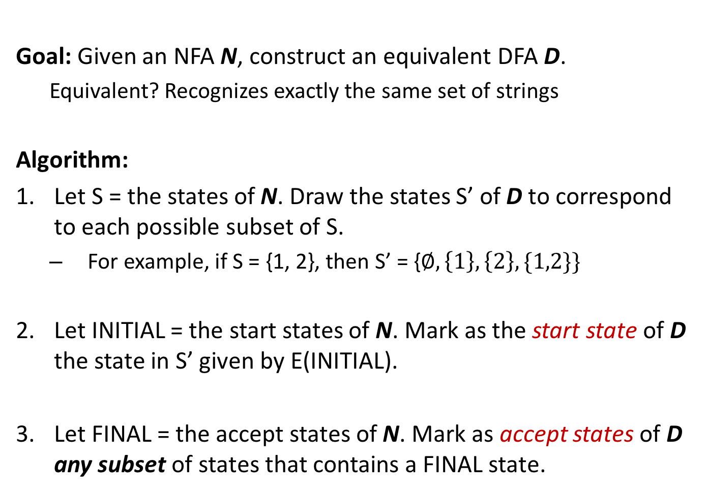
NFA->DFA
Goal: Given an NFA N, construct an equivalent DFA D.
Equivalent? Recognizes exactly the same set of strings
Algorithm:
Let S = the states of N. Draw the states S’ of D to correspond to each possible subset of S.
For example, if S = {1, 2}, then S’ = {$∅, \left\{1\right\}, \left\{2\right\}, \{1,2\}\}$
Let INITIAL = the start states of N. Mark as the start state of D the state in S’ given by E(INITIAL).
Let FINAL = the accept states of N. Mark as accept states of D any subset of states that contains a FINAL state.

Slide 47
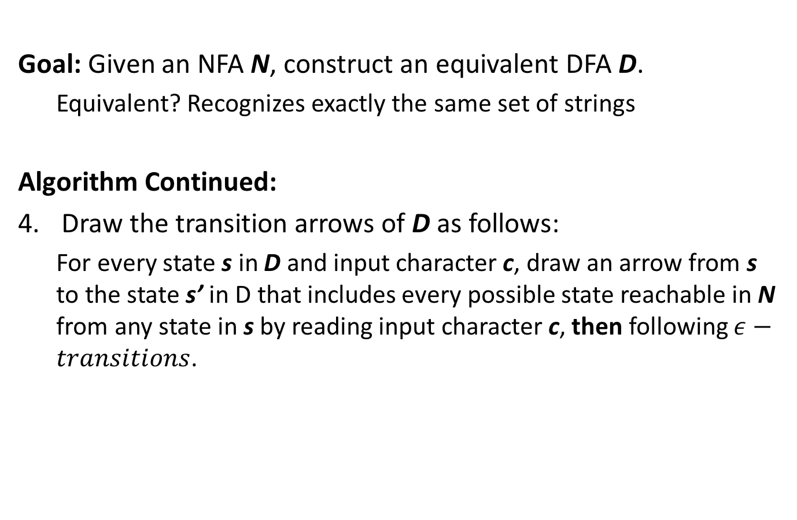
NFA->DFA
Goal: Given an NFA N, construct an equivalent DFA D.
Equivalent? Recognizes exactly the same set of strings
Algorithm Continued:
Draw the transition arrows of D as follows:
For every state s in D and input character c, draw an arrow from s to the state s’ in D that includes every possible state reachable in N from any state in s by reading input character c, then following $ε−transitions$.
Recall that the
states s of D
correspond to
sets of states of N.
This rule is quite confusing…
Let’s consider an example.

Slide 48
NFA->DFA Example
Example 1.42 in
Sipser’s “Intro. to Computation Theory”
INITIAL
a
Does this NFA accept:
“a”?
“bb”?
“baa”?
“bba”?
“baaaaaaaaab”?
“baaaaaaaaaba”?
Read either a or b

Slide 49
NFA->DFA Example
Example 1.42 in
Sipser’s “Intro. to Computation Theory”
INITIAL
a
Does this NFA accept:
“a”? YES
“bb”? NO
“baa”? YES
“bba”? YES
“baaaaaaaaab”? NO
“baaaaaaaaaba”? YES
Read either a or b

Slide 50
NFA->DFA Example
INITIAL
Algorithm:
Let S = the states of N. Draw the states S’ of D to correspond to each possible subset of S.
a

Slide 51
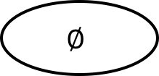
NFA->DFA Example
INITIAL
Algorithm:
Let S = the states of N. Draw the states S’ of D to correspond to each possible subset of S.
a
$$∅$$
{1}
{2}
{1,2}
{3}
{1,3}
{2,3}
{1,2,3}

Slide 52
NFA->DFA Example
INITIAL
Algorithm:
…
Let INITIAL = the start states of N. Mark as the start state of D the state in S’ given by E(INITIAL).
a
$$∅$$
{1}
{2}
{1,2}
{3}
{1,3}
{2,3}
{1,2,3}

Slide 53
NFA->DFA Example
INITIAL
Algorithm:
…
Let INITIAL = the start states of N. Mark as the start state of D the state in S’ given by E(INITIAL).
a
$$∅$$
{1}
{2}
{1,2}
INITIAL
{3}
{1,3}
{2,3}
{1,2,3}

Slide 54
NFA->DFA Example
INITIAL
Algorithm:
…
Let FINAL = the accept states of N. Mark as accept states of D any subset of states that contains a FINAL state.
a
$$∅$$
{1}
{2}
{1,2}
INITIAL
{3}
{1,3}
{2,3}
{1,2,3}

Slide 55
NFA->DFA Example
INITIAL
Algorithm:
…
Let FINAL = the accept states of N. Mark as accept states of D any subset of states that contains a FINAL state.
a
$$∅$$
{1}
{2}
{1,2}
INITIAL
{3}
{1,3}
{2,3}
{1,2,3}

Slide 56
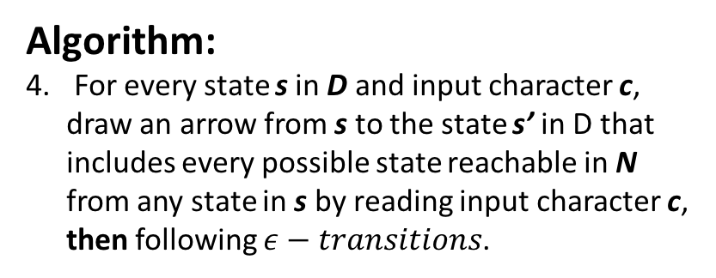
NFA->DFA Example
INITIAL
Algorithm:
For every state s in D and input character c, draw an arrow from s to the state s’ in D that includes every possible state reachable in N from any state in s by reading input character c, then following $ε−transitions$.
a
Consider state {2} on input a…
$$∅$$
{1}
{2}
{1,2}
INITIAL
{3}
{1,3}
{2,3}
{1,2,3}

Slide 57
NFA->DFA Example
INITIAL
Algorithm:
For every state s in D and input character c, draw an arrow from s to the state s’ in D that includes every possible state reachable in N from any state in s by reading input character c, then following $ε−transitions$.
a
Now on input b…
$$∅$$
{1}
{2}
{1,2}
a
INITIAL
{3}
{1,3}
{2,3}
{1,2,3}

Slide 58
NFA->DFA Example
INITIAL
Algorithm:
For every state s in D and input character c, draw an arrow from s to the state s’ in D that includes every possible state reachable in N from any state in s by reading input character c, then following $ε−transitions$.
a
$$∅$$
{1}
{2}
{1,2}
b
a
INITIAL
{3}
{1,3}
{2,3}
{1,2,3}

Slide 59
NFA->DFA Example
INITIAL
Algorithm:
For every state s in D and input character c, draw an arrow from s to the state s’ in D that includes every possible state reachable in N from any state in s by reading input character c, then following $ε−transitions$.
a
$$∅$$
{1}
{2}
{1,2}
b
a
INITIAL
{3}
{1,3}
{2,3}
{1,2,3}

Slide 60
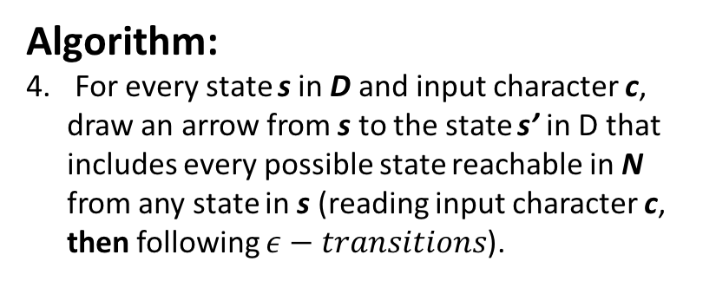
NFA->DFA Example
INITIAL
Algorithm:
For every state s in D and input character c, draw an arrow from s to the state s’ in D that includes every possible state reachable in N from any state in s (reading input character c, then following $ε−transitions$).
Transition table for NFA to the left:
State\Char | a | b
1
2 | {2,3} | {3}
3
a
$$∅$$
{1}
{2}
{1,2}
b
a
INITIAL
{3}
{1,3}
{2,3}
{1,2,3}

Slide 61
NFA->DFA Example
INITIAL
Algorithm:
For every state s in D and input character c, draw an arrow from s to the state s’ in D that includes every possible state reachable in N from any state in s (reading input character c, then following $ε−transitions$).
Transition table for NFA to the left:
State\Char | a | b
1
2 | {2,3} | {3}
3 | {1,3}
a
$$∅$$
{1}
{2}
{1,2}
b
a
INITIAL
{3}
{1,3}
{2,3}
{1,2,3}

Slide 62
NFA->DFA Example
INITIAL
Algorithm:
For every state s in D and input character c, draw an arrow from s to the state s’ in D that includes every possible state reachable in N from any state in s (reading input character c, then following $ε−transitions$).
Transition table for NFA to the left:
State\Char | a | b
1
2 | {2,3} | {3}
3 | {1,3}
a
$$∅$$
{1}
{2}
{1,2}
b
a
INITIAL
{3}
{1,3}
{2,3}
{1,2,3}
a

Slide 63
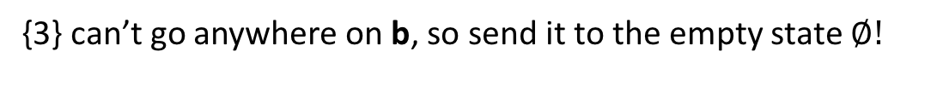
NFA->DFA Example
INITIAL
Algorithm:
For every state s in D and input character c, draw an arrow from s to the state s’ in D that includes every possible state reachable in N from any state in s (reading input character c, then following $ε−transitions$).
Transition table for NFA to the left:
State\Char | a | b
1
2 | {2,3} | {3}
3 | {1,3} | {}
a
{3} can’t go anywhere on b, so send it to the empty state $∅!$
$$∅$$
{1}
{2}
{1,2}
b
b
a
INITIAL
{3}
{1,3}
{2,3}
{1,2,3}
a

Slide 64
NFA->DFA Example
INITIAL
Algorithm:
For every state s in D and input character c, draw an arrow from s to the state s’ in D that includes every possible state reachable in N from any state in s (reading input character c, then following $ε−transitions$).
Transition table for NFA to the left:
State\Char | a | b
1 | {} | {2}
2 | {2,3} | {3}
3 | {1,3} | {}
a
$$∅$$
{1}
{2}
{1,2}
b
b
a
INITIAL
{3}
{1,3}
{2,3}
{1,2,3}
a

Slide 65
NFA->DFA Example
INITIAL
Algorithm:
For every state s in D and input character c, draw an arrow from s to the state s’ in D that includes every possible state reachable in N from any state in s (reading input character c, then following $ε−transitions$).
Transition table for NFA to the left:
State\Char | a | b
1 | {} | {2}
2 | {2,3} | {3}
3 | {1,3} | {}
a
$$∅$$
{1}
{2}
{1,2}
b
b
a
INITIAL
{3}
{1,3}
{2,3}
{1,2,3}
a
a

Slide 66
NFA->DFA Example
INITIAL
Algorithm:
For every state s in D and input character c, draw an arrow from s to the state s’ in D that includes every possible state reachable in N from any state in s (reading input character c, then following $ε−transitions$).
Transition table for NFA to the left:
State\Char | a | b
1 | {} | {2}
2 | {2,3} | {3}
3 | {1,3} | {}
a
$$∅$$
{1}
{2}
{1,2}
b
b
b
a
INITIAL
{3}
{1,3}
{2,3}
{1,2,3}
a
a

Slide 67
NFA->DFA Example
INITIAL
Algorithm:
For every state s in D and input character c, draw an arrow from s to the state s’ in D that includes every possible state reachable in N from any state in s (reading input character c, then following $ε−transitions$).
Transition table for NFA to the left:
State\Char | a | b
1 | {} | {2}
2 | {2,3} | {3}
3 | {1,3} | {}
a
$$∅$$
{1}
{2}
{1,2}
b
b
b
a
INITIAL
{3}
{1,3}
{2,3}
{1,2,3}
a
a

Slide 68
NFA->DFA Example
INITIAL
Algorithm:
For every state s in D and input character c, draw an arrow from s to the state s’ in D that includes every possible state reachable in N from any state in s (reading input character c, then following $ε−transitions$).
Transition table for NFA to the left:
State\Char | a | b
1 | {} | {2}
2 | {2,3} | {3}
3 | {1,3} | {}
a
$$∅$$
{1}
{2}
{1,2}
b
b
a
b
a
INITIAL
{3}
{1,3}
{2,3}
{1,2,3}
a
a

Slide 69
NFA->DFA Example
INITIAL
Algorithm:
For every state s in D and input character c, draw an arrow from s to the state s’ in D that includes every possible state reachable in N from any state in s (reading input character c, then following $ε−transitions$).
Transition table for NFA to the left:
State\Char | a | b
1 | {} | {2}
2 | {2,3} | {3}
3 | {1,3} | {}
a
$$∅$$
{1}
{2}
{1,2}
b
b
a, b
b
a
INITIAL
{3}
{1,3}
{2,3}
{1,2,3}
a
a

Slide 70
NFA->DFA Example
INITIAL
Algorithm:
For every state s in D and input character c, draw an arrow from s to the state s’ in D that includes every possible state reachable in N from any state in s (reading input character c, then following $ε−transitions$).
Transition table for NFA to the left:
State\Char | a | b
1 | {} | {2}
2 | {2,3} | {3}
3 | {1,3} | {}
a
$$∅$$
{1}
{2}
{1,2}
b
b
a, b
b
a
INITIAL
{3}
{1,3}
{2,3}
{1,2,3}
a
a

Slide 71
NFA->DFA Example
INITIAL
Algorithm:
For every state s in D and input character c, draw an arrow from s to the state s’ in D that includes every possible state reachable in N from any state in s (reading input character c, then following $ε−transitions$).
Transition table for NFA to the left:
State\Char | a | b
1 | {} | {2}
2 | {2,3} | {3}
3 | {1,3} | {}
a
$$∅$$
{1}
{2}
{1,2}
b
b
a, b
b
a
INITIAL
a
{3}
{1,3}
{2,3}
{1,2,3}
a
a

Slide 72
NFA->DFA Example
INITIAL
Algorithm:
For every state s in D and input character c, draw an arrow from s to the state s’ in D that includes every possible state reachable in N from any state in s (reading input character c, then following $ε−transitions$).
Transition table for NFA to the left:
State\Char | a | b
1 | {} | {2}
2 | {2,3} | {3}
3 | {1,3} | {}
a
$$∅$$
{1}
{2}
{1,2}
b
b
a, b
b
a
INITIAL
a
{3}
{1,3}
{2,3}
b
{1,2,3}
a
a

Slide 73
NFA->DFA Example
INITIAL
Algorithm:
For every state s in D and input character c, draw an arrow from s to the state s’ in D that includes every possible state reachable in N from any state in s (reading input character c, then following $ε−transitions$).
Transition table for NFA to the left:
State\Char | a | b
1 | {} | {2}
2 | {2,3} | {3}
3 | {1,3} | {}
a
$$∅$$
{1}
{2}
{1,2}
b
b
a, b
b
a
INITIAL
a
{3}
{1,3}
{2,3}
b
{1,2,3}
a
a

Slide 74
NFA->DFA Example
INITIAL
Algorithm:
For every state s in D and input character c, draw an arrow from s to the state s’ in D that includes every possible state reachable in N from any state in s (reading input character c, then following $ε−transitions$).
Transition table for NFA to the left:
State\Char | a | b
1 | {} | {2}
2 | {2,3} | {3}
3 | {1,3} | {}
a
$$∅$$
a
{1}
{2}
{1,2}
b
b
a, b
b
a
INITIAL
a
{3}
{1,3}
{2,3}
b
{1,2,3}
a
a

Slide 75
NFA->DFA Example
INITIAL
Algorithm:
For every state s in D and input character c, draw an arrow from s to the state s’ in D that includes every possible state reachable in N from any state in s (reading input character c, then following $ε−transitions$).
Transition table for NFA to the left:
State\Char | a | b
1 | {} | {2}
2 | {2,3} | {3}
3 | {1,3} | {}
a
$$∅$$
a
{1}
b
{2}
{1,2}
b
b
a, b
b
a
INITIAL
a
{3}
{1,3}
{2,3}
b
{1,2,3}
a
a

Slide 76
NFA->DFA Example
INITIAL
Algorithm:
For every state s in D and input character c, draw an arrow from s to the state s’ in D that includes every possible state reachable in N from any state in s (reading input character c, then following $ε−transitions$).
Transition table for NFA to the left:
State\Char | a | b
1 | {} | {2}
2 | {2,3} | {3}
3 | {1,3} | {}
a
$$∅$$
a
{1}
b
{2}
{1,2}
b
b
a, b
b
a
INITIAL
a
{3}
{1,3}
{2,3}
b
{1,2,3}
a
a

Slide 77
NFA->DFA Example
INITIAL
Algorithm:
For every state s in D and input character c, draw an arrow from s to the state s’ in D that includes every possible state reachable in N from any state in s (reading input character c, then following $ε−transitions$).
Transition table for NFA to the left:
State\Char | a | b
1 | {} | {2}
2 | {2,3} | {3}
3 | {1,3} | {}
a
$$∅$$
a
{1}
b
{2}
{1,2}
b
b
a, b
b
a
INITIAL
a
{3}
{1,3}
{2,3}
b
{1,2,3}
a
a
a

Slide 78
NFA->DFA Example
INITIAL
Algorithm:
For every state s in D and input character c, draw an arrow from s to the state s’ in D that includes every possible state reachable in N from any state in s (reading input character c, then following $ε−transitions$).
Transition table for NFA to the left:
State\Char | a | b
1 | {} | {2}
2 | {2,3} | {3}
3 | {1,3} | {}
a
$$∅$$
a
{1}
b
{2}
{1,2}
b
b
a, b
b
a
INITIAL
a
{3}
{1,3}
a
{2,3}
b
{1,2,3}
a
b
a

Slide 79

NFA->DFA Example
INITIAL
Algorithm:
For every state s in D and input character c, draw an arrow from s to the state s’ in D that includes every possible state reachable in N from any state in s (reading input character c, then following $ε−transitions$).
Transition table for NFA to the left:
State\Char | a | b
1 | {} | {2}
2 | {2,3} | {3}
3 | {1,3} | {}
a
What about transitions from $∅?$
$$∅$$
a
{1}
b
{2}
{1,2}
b
b
a, b
b
a
INITIAL
a
{3}
{1,3}
a
{2,3}
b
{1,2,3}
a
b
a

Slide 80
NFA->DFA Example
INITIAL
Algorithm:
For every state s in D and input character c, draw an arrow from s to the state s’ in D that includes every possible state reachable in N from any state in s (reading input character c, then following $ε−transitions$).
Transition table for NFA to the left:
State\Char | a | b
1 | {} | {2}
2 | {2,3} | {3}
3 | {1,3} | {}
a
a, b
$$∅$$
a
{1}
b
{2}
{1,2}
b
b
a, b
b
a
INITIAL
a
{3}
{1,3}
a
{2,3}
b
{1,2,3}
a
b
a

Slide 81
NFA->DFA Example
INITIAL
Does this DFA accept:
“a”? YES
“bb”? NO
“baa”? YES
“bba”? YES
“baaaaaaaaab”? NO
“baaaaaaaaaba”? YES
a
a, b
$$∅$$
a
{1}
b
{2}
{1,2}
b
b
a, b
b
a
INITIAL
a
{3}
{1,3}
a
{2,3}
b
{1,2,3}
a
b
a

Slide 82
Removing Unreachable States
INITIAL
Does this DFA accept:
“a”? YES
“bb”? NO
“baa”? YES
“bba”? YES
“baaaaaaaaab”? NO
“baaaaaaaaaba”? YES
a
a, b
$$∅$$
{2}
b
b
b
a
INITIAL
a
{3}
{1,3}
a
{2,3}
b
{1,2,3}
a
b
a

Slide 83
RE->NFA

Slide 84
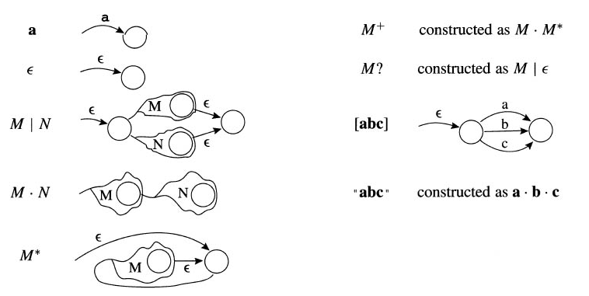
Converting REs to NFAs
r
= Recursively apply rules to the left
to regular expression r, connecting
heads and tails as you go
Every RE is encodable as an equivalent NFA
(and thus also an equivalent DFA)
Reminder: equivalent = accepts exactly the
same set of strings
[Appel 2.4]

Slide 85
Example 1
= Recursively apply rules to the left
to regular expression r, connecting
heads and tails as you go
INIT
a . b
[Appel 2.4]

Slide 86
Example 1
= Recursively apply rules to the left
to regular expression r, connecting
heads and tails as you go
INIT
a
b
[Appel 2.4]

Slide 87
Example 1
= Recursively apply rules to the left
to regular expression r, connecting
heads and tails as you go
INIT
b
a
[Appel 2.4]

Slide 88
Example 1
= Recursively apply rules to the left
to regular expression r, connecting
heads and tails as you go
INIT
a
b
[Appel 2.4]

Slide 89
Example 2
Convert the following RE to an equivalent NFA:
(a | b)*
INIT
(a | b)*

Slide 90
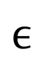
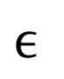
Example 2
Convert the following RE to an equivalent NFA:
(a | b)*
INIT
$$ϵ$$
$$ϵ$$
a | b

Slide 91
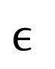
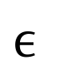
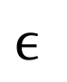
Example 2
Convert the following RE to an equivalent NFA:
(a | b)*
INIT
$$ϵ$$
a
$$ϵ$$
$$ϵ$$
$$ϵ$$
b

Slide 92
Example 2
Convert the following RE to an equivalent NFA:
(a | b)*
INIT
$$ϵ$$
a
$$ϵ$$
$$ϵ$$
$$ϵ$$
b

Slide 93
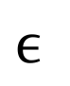
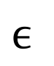
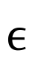
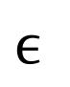
A More Conventional Drawing of the Same NFA
Convert the following RE to an equivalent NFA:
(a | b)*
a
b
$$ϵ$$
INIT
$$ϵ$$
$$ϵ$$
$$ϵ$$

Slide 94
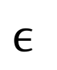
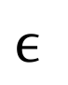
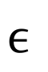
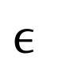
RE->NFA->DFA
Convert the following RE to an equivalent NFA:
(a | b)*
4
a
b
Label states
3
5
$$ϵ$$
INIT
$$ϵ$$
$$ϵ$$
1
$$ϵ$$
2

Slide 95
RE->NFA->DFA
Convert the following RE to an equivalent NFA:
(a | b)*
4
a
b
Label states
Construct transition table
3
5
$$ϵ$$
INIT
$$ϵ$$
$$ϵ$$
1
$$ϵ$$
2
State/Char | a | b
1 | {} | {}
2 | {} | {}
3 | {} | {}
4 | {2,3,4} | {2,4,5}
5 | {} | {}

Slide 96
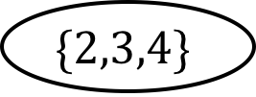
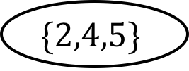
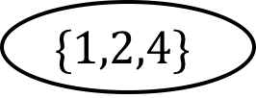
RE->NFA->DFA
Convert the following RE to an equivalent NFA:
(a | b)*
4
a
b
Label states
Construct transition table
DFA states
3
5
$$ϵ$$
INIT
$$ϵ$$
$$ϵ$$
1
$$ϵ$$
2
$$\{1,2,4\}$$
State/Char | a | b
1 | {} | {}
2 | {} | {}
3 | {} | {}
4 | {2,3,4} | {2,4,5}
5 | {} | {}
$$\{2,3,4\}$$
$$\{2,4,5\}$$

Slide 97
RE->NFA->DFA
Convert the following RE to an equivalent NFA:
(a | b)*
4
a
b
Label states
Construct transition table
DFA states
Init and final
3
5
$$ϵ$$
INIT
$$ϵ$$
$$ϵ$$
1
2
INIT
$$ϵ$$
$$\{1,2,4\}$$
State/Char | a | b
1 | {} | {}
2 | {} | {}
3 | {} | {}
4 | {2,3,4} | {2,4,5}
5 | {} | {}
$$\{2,3,4\}$$
$$\{2,4,5\}$$

Slide 98
RE->NFA->DFA
Convert the following RE to an equivalent NFA:
(a | b)*
4
Label states
Construct transition table
DFA states
Init and final
Mark transitions
a
b
3
5
$$ϵ$$
INIT
$$ϵ$$
$$ϵ$$
1
2
INIT
$$ϵ$$
$$\{1,2,4\}$$
State/Char | a | b
1 | {} | {}
2 | {} | {}
3 | {} | {}
4 | {2,3,4} | {2,4,5}
5 | {} | {}
a
b
b
b
$$\{2,3,4\}$$
a
$$\{2,4,5\}$$
a

Slide 99
OCAMLLEX

Slide 100
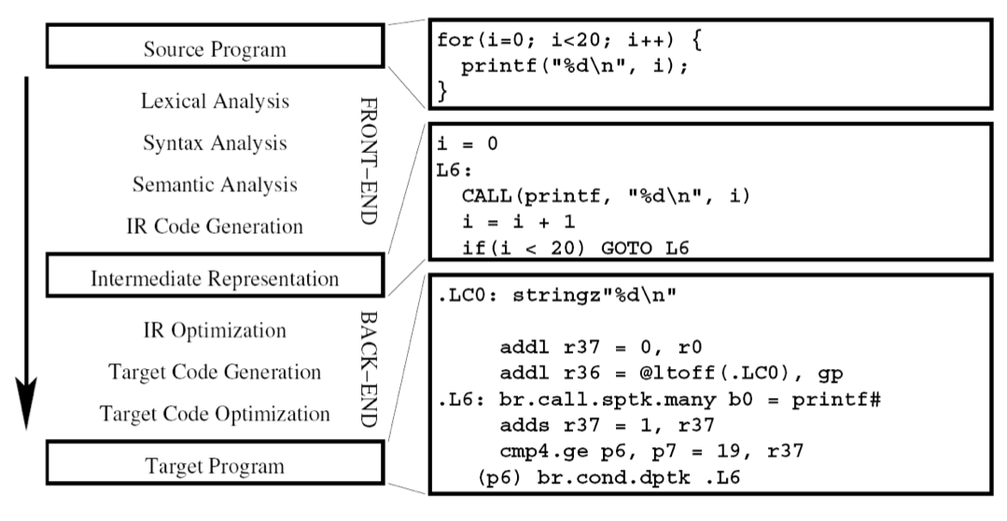
Demo: ocamllex
The RE->NFA->DFA reduction is mechanical and tedious
Fortunately, people have written computer programs (e.g., ocamllex) to automate this process for us!
Following a long line of similar tools for other languages (e.g., lex for C)

Slide 101
The Grumpy Online Visual Debugger
Lexing Grumpy (lexer.mll)
https://bagnalla.github.io/webgrumpy/

Slide 102
EXTRAS: DFA MINIMIZATION

Slide 103
Minimal DFAs
A DFA D is minimal if there is no equivalent DFA D’ with strictly fewer states
Equivalent? Accepts the same language, or set of strings
The minimal DFA for a given language is unique (up to renamings of states)
How to minimize?
[Moore ‘56]
[Brzozowski ‘63]
…

Slide 104
The Brzozowski Minimization Procedure
INPUT DFA D
OUTPUT DFA D’ minimizing D
Algorithm:
Convert D to NFA R(D), the “reversal” of D
Convert R(D) to D_{R} using powerset algorithm of previous slides
Convert D_{R} to NFA R(D_{R})
Convert R(D_{R}) to (D_{R})_{R} = D’
Reversal R(D) = D with all arrows reversed, INIT=FINAL, FINAL=INIT

